Slide 1

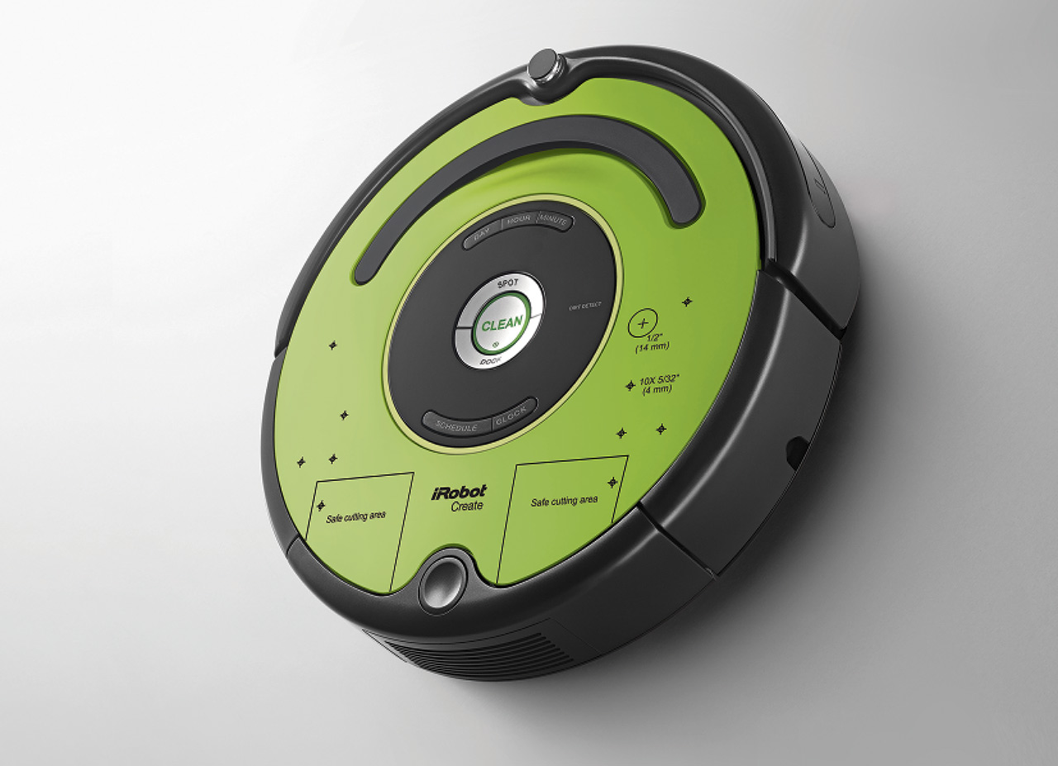
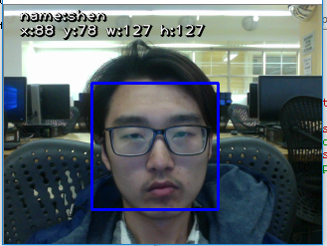
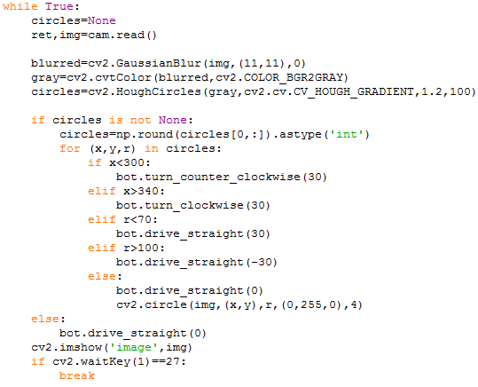
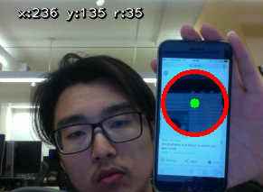
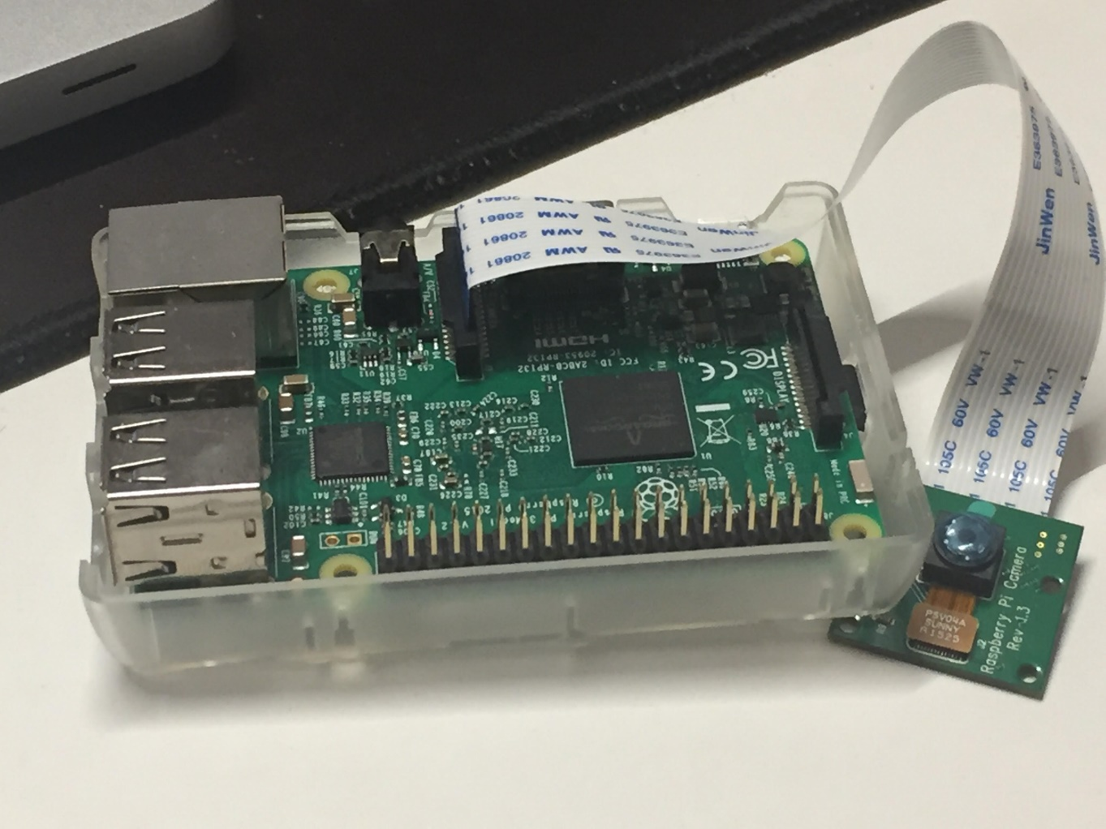
Mobile Robots With Remote Access And Image Detection
Yu Shenghui | Praveen Khethavath | LaGuardia Community College
Problem Description
iRobot Create II
Sample Code and Result
The goal of this project is to create programs that make robots be able to make decisions and navigate by itself. For many situations, people would not like to work because of the risk of danger, such as underwater exploration, fix oil spills, military service, etc. In such cases, mobile robots would be great choice. The robot I used in this project is iRobot Create 2. It can move, sense, and make sound upon commands received from connected computer. By running programs, commands would be sent to the robot using serial communication port, which means it would be able to make decisions and behave by itself responding to appropriate commands. However, a problem I faced was that if a computer is connected to the robot it could work only in a small range of places because of the size of computer on it.
Solution
Methods
To solve this problem, I had to remotely control it. Raspberry Pi is a mini computer that could be remotely controlled in VNC or using SSH from any computers while all devices are connecting to internet. Because the raspberry Pi is small, it can be connected and carried by robot while the robot is working. We also used cameras boards connected to the robot to track objects. So, we can now use the camera to send commands to robot and navigate efficiently. The camera module is programmed using openCV to identify, track objects and people.
Programming to control the robot:
Find an application programming interface (API) for iRobot Create 2 and programming language—python
Use methods in the API to make the robot move, sense, return collected data.
Remote access raspberry pi to run programs for the robot:
Have a raspberry Pi to send and receive data from the robot
Build essential applications in raspberry Pi, such as python IDLE, openCV, etc.
Enable VNC(Virtual Network Computing), SSH(Secure Shell) of raspberry Pi in order to remote access it.
Build camera on raspberry Pi and programming for the camera vision detection:
Build openCV in raspberry Pi
Use methods in openCV programming interface to detect, track objects.
Applications
By this research project, we would be able to:
Use robot as walk dog to assist bind people
Use robot to collect data or objects in risky environment
Transportation
Object detection, tracking and recognition
Raspberry Pi
Works Cited
Acknowledgements
@article{opencv_library,
author = {Bradski, G.},
citeulike-article-id = {2236121},
journal = {Dr. Dobb's Journal of Software Tools},
keywords = {bibtex-import},
posted-at = {2008-01-15 19:21:54},
priority = {4},
title = ,
year = {2000} }
This project is supported by NIH BRIDGES

